Slide 1
Unconstrained Optimisation
Lectures 1 - 6
Le Yang and Jeremy Watson
ENEL445-26S1
Department of ECE, University of Canterbury

Slide 2

Course notes
Under ‘Course Reader’ of the ENEL445 course LEARN page

Slide 3
Generic Problem formulation
Unconstrained optimisation problem
Key assumptions:
Continuous and differentiable scalar objective function (C² smooth)
Design variables subject to range constraints
These constraints can be eliminated via design variable transformation (see next slide)
Iterative approach is used

Slide 4
Transformation of Design Variables
Softplus function
Sigmoid function
Hyperbolic tangent function

Slide 5
Challenges
Convexity of the objective function not always guaranteed
Multimodality of the objective function
Hard to know whether the objective function is unimodal or multimodal
Finding the global minimum is always desired but difficult
Local convergence
An efficient approach: multi-start initialization
If we reach the same minimum from distant starting points, it is likely that is the global minimum (still no guarantee)
How to cover the space of the design variables efficiently with a limited number of initial points? (more in next week)

Slide 6
Gradient-free v.s. Gradient based (1)
Gradient-free methods
As long as the objective function (and constraints) is numerically computable
Easy to set up and widely applicable (no requirement on the continuity or smoothness of any function)
Heuristic, nature-inspired but computationally intensive
Example: genetic algorithms, particle swarm optimization (PSO) ...

Slide 7
Gradient-free v.s. Gradient based (2)
Gradient-based methods
Gradient-guided search of the design variable space
Gradient provides information on the local rate of change in the objective function value but still enables global searching ability
Gradient provides information for stopping the iteration
Optimality conditions
Gradient can be computed in closed-form or numerically
Gradient-based techniques’ complexity scales nicely with the problem dimensionality

Slide 8
Taylor-Series Expansion Re-visited (1)
Univariate case

Slide 9
Taylor-Series Expansion Re-visited (2)
Multivariate case

Slide 10
Gradient
Definition
Geometrical intepretation
Examples

Slide 12
Hessian
Definition
Geometrical intepretation
Examples

Slide 14
Gradient-based Iterative Solution to Unconstrained Optimization Problems
Generic form
Key design questions
How to select the initial solution x₀ , multi-start strategy
When to terminate the iteration, optimality condition
How to find the search direction, closed-form or numerical evaluation
How to determine the step size a_{k}

Slide 15
Optimality Conditions
Necessary conditions

Slide 16
Stopping Criteria

Slide 17
Multi-start Initialization
Educated guesses based on the understanding of the optimization problem
Naive full factorial sampling
Uniform grid to discretize each design variable
Curse of dimensionality: number of grid points grows exponentially with the problem dimensionality
Random sampling
Inefficient if some samples are clusters

Slide 18
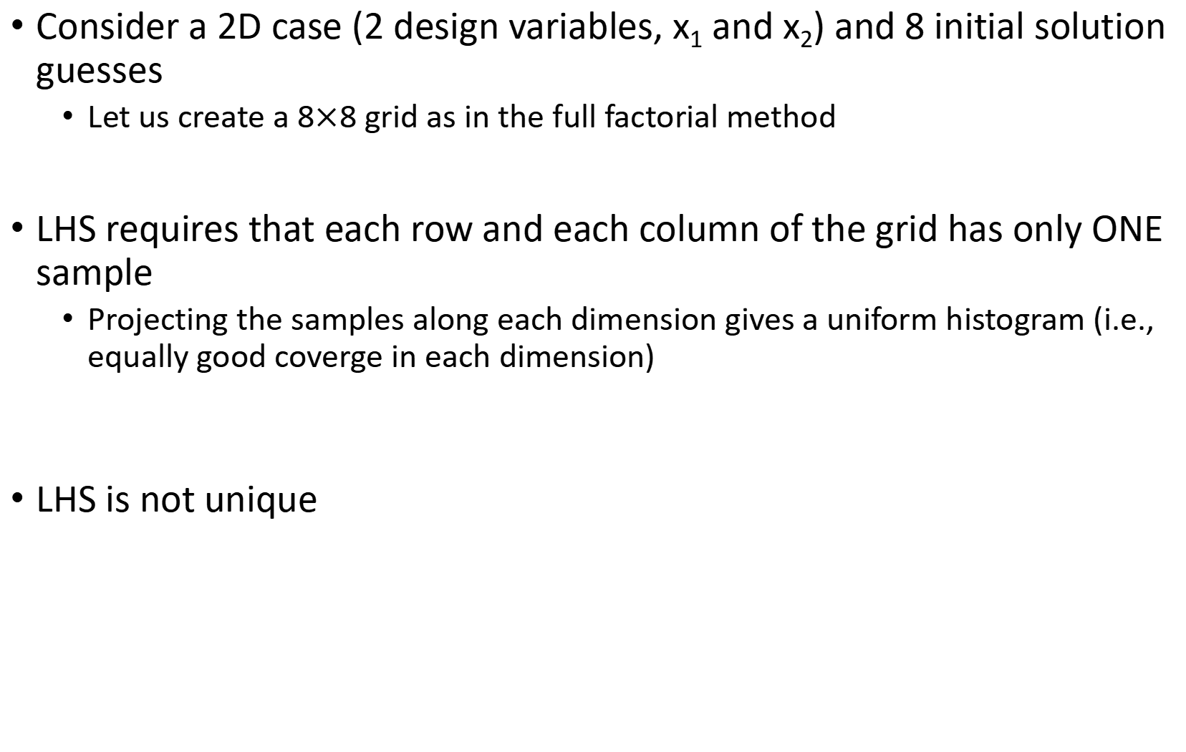
Latin Hypercube Sampling (LHS)
Consider a 2D case (2 design variables, x₁ and x₂) and 8 initial solution guesses
Let us create a 8$×$8 grid as in the full factorial method
LHS requires that each row and each column of the grid has only ONE sample
Projecting the samples along each dimension gives a uniform histogram (i.e., equally good coverge in each dimension)
LHS is not unique

Slide 19
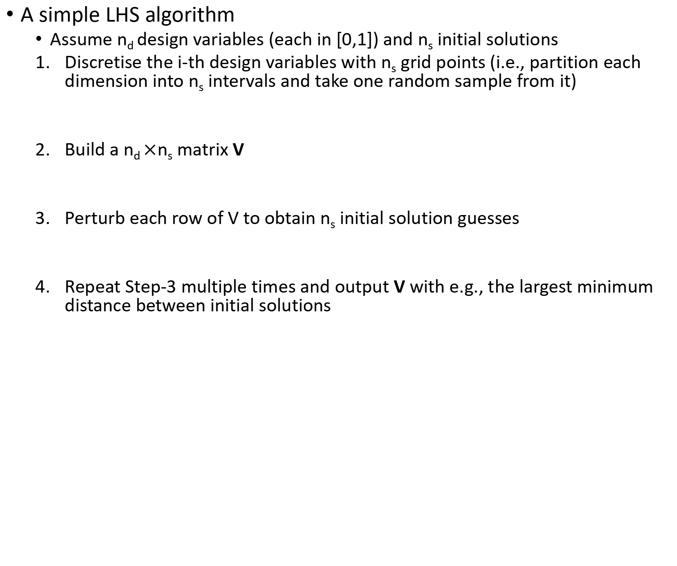
Latin Hypercube Sampling (LHS) Continued
A simple LHS algorithm
Assume n_{d} design variables (each in [0,1]) and n_{s} initial solutions
Discretise the i-th design variables with n_{s} grid points (i.e., partition each dimension into n_{s} intervals and take one random sample from it)
Build a n_{d} $×$n_{s} matrix V
Perturb each row of V to obtain n_{s} initial solution guesses
Repeat Step-3 multiple times and output V with e.g., the largest minimum distance between initial solutions

Slide 21
Halton and Hammersley Sequences (1)
Family of low-discrepancy sequences
Discrepency: variation of the sample density over the design variable space
Even sample density
Deterministic (quasi-random) and spatially spread
Attractive property for multi-start initialization: sequence length can be increased on-the-fly
Newly added samples maintain low discrepancy
Good for numiercal integration, Monte Carlo simulation, multi-start initialization

Slide 22
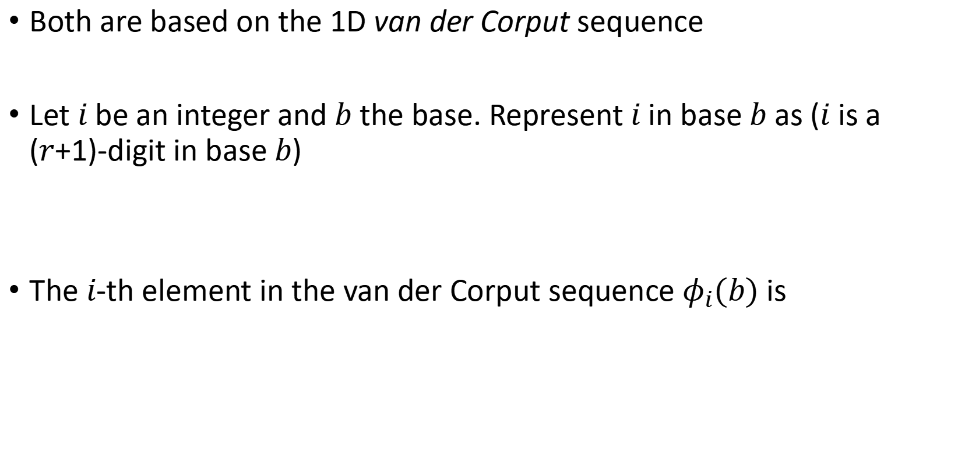
Halton and Hammersley Sequences (2)
Both are based on the 1D van der Corput sequence
Let $i$ be an integer and $b$ the base. Represent $i$ in base $b$ as ($i$ is a ($r$+1)-digit in base $b$)
The $i$-th element in the van der Corput sequence $φ_{i}(b)$ is

Slide 23

Example van der Corput sequence with $b=2$

Slide 24

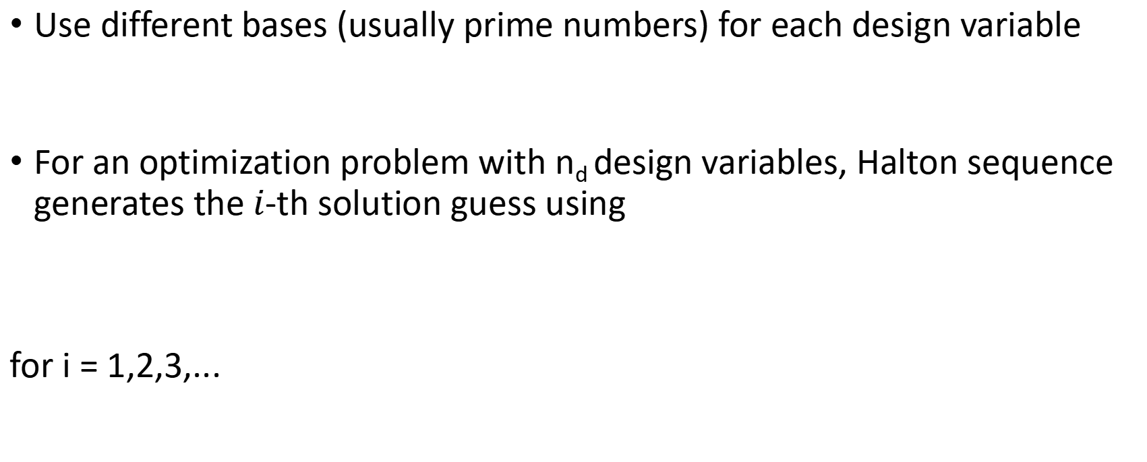
Halton and Hammersley Sequences (3)
Use different bases (usually prime numbers) for each design variable
For an optimization problem with n_{d} design variables, Halton sequence generates the $i$-th solution guess using
for i = 1,2,3,...

Slide 25

Halton and Hammersley Sequences (4)
Hammersley sequence is a special case of the Halton sequence
The number of points to be generated n_{p} needs to be known in advance
The first design variable uses regular spacing

Slide 26
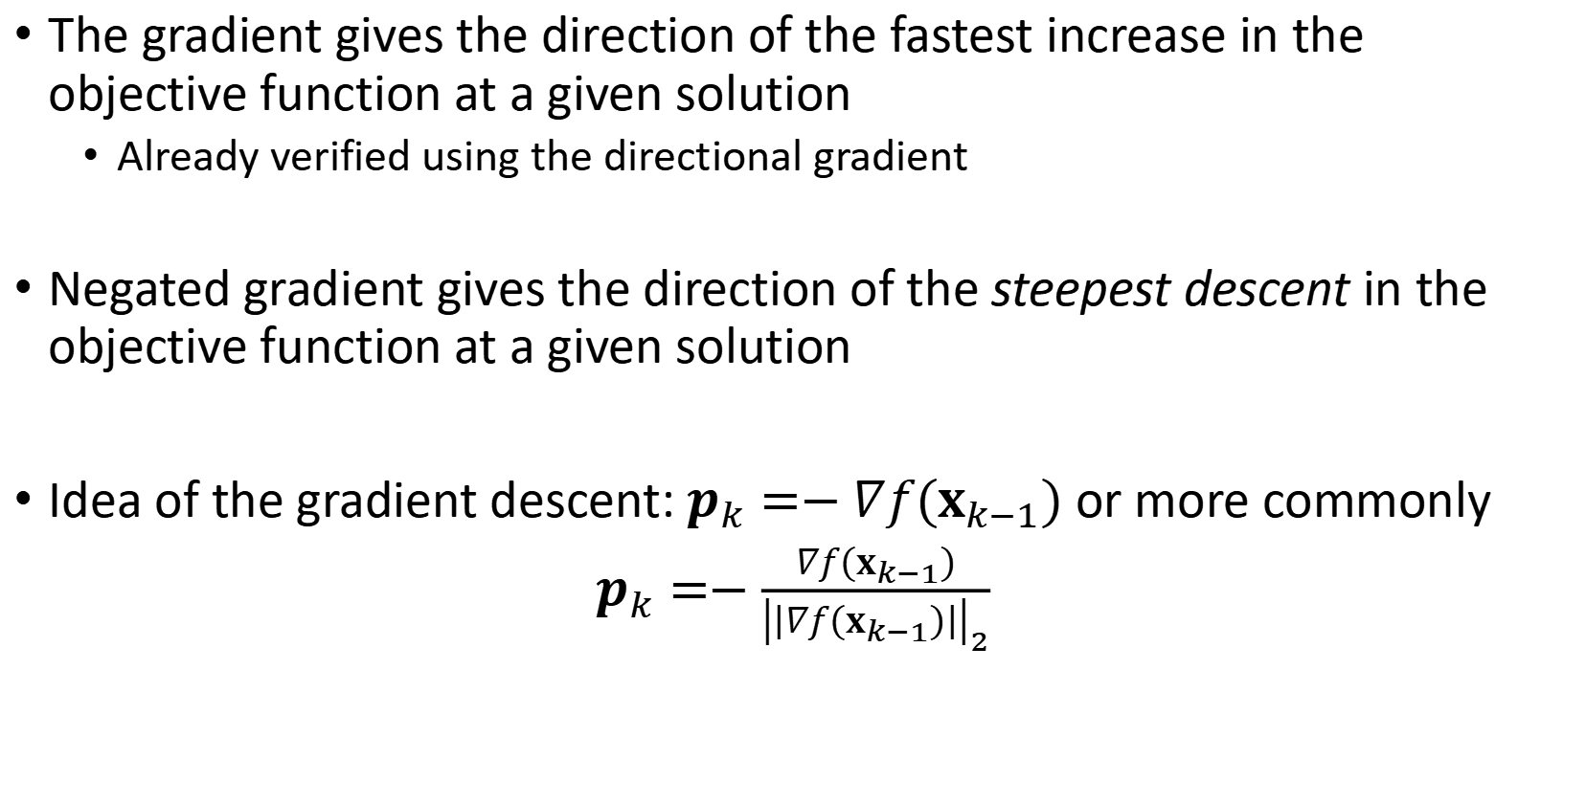
Gradient Descent (1)
The gradient gives the direction of the fastest increase in the objective function at a given solution
Already verified using the directional gradient
Negated gradient gives the direction of the steepest descent in the objective function at a given solution
Idea of the gradient descent: $p_{k}=−∇f(x_{k−1})$ or more commonly
$p_{k}=−\frac{∇f\left(x_{k−1}\right)}{{\left|\left|∇f\left(x_{k−1}\right)\right|\right|}_{2}}$

Slide 27
Effect of Scaling
The elements of the gradient may have very different magnitude
Scale the design variables to make all of them have an order of magnitude of 1: normalization

Slide 28
Gradient Descent (2)
Gradient descent may be highly inefficient even after scaling the design variables, when the Hessian matrix has a large condition number (the curvature of the objective function varies greatly with the direction)
The zigzagging behavior with exact line search

Slide 29
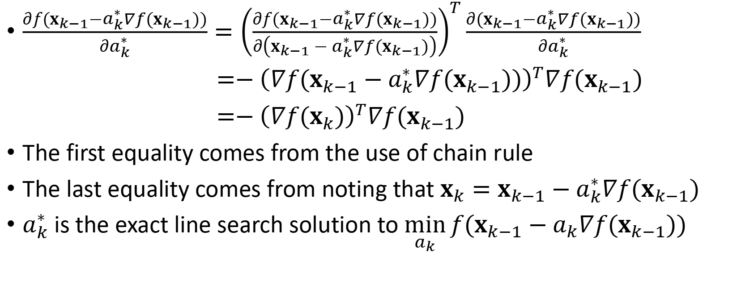
$\frac{∂f(x_{k−1}−a_{k}^{∗}{∇f(x}_{k−1}))}{∂a_{k}^{∗}}={\left(\frac{∂f(x_{k−1}−a_{k}^{∗}{∇f(x}_{k−1}))}{∂\left(x_{k−1}−a_{k}^{∗}{∇f(x}_{k−1})\right)}\right)}^{T}\frac{∂(x_{k−1}−a_{k}^{∗}{∇f(x}_{k−1}))}{∂a_{k}^{∗}}$
$=−{\left(∇f(x_{k−1}−a_{k}^{∗}{∇f(x}_{k−1}))\right)}^{T}{∇f(x}_{k−1})$
$=−{\left(∇f(x_{k})\right)}^{T}{∇f(x}_{k−1})$
The first equality comes from the use of chain rule
The last equality comes from noting that $x_{k}=x_{k−1}−a_{k}^{∗}{∇f(x}_{k−1})$
$a_{k}^{∗}$ is the exact line search solution to $\min_{a_{k}}{f(x_{k−1}−a_{k}{∇f(x}_{k−1}))}$

Slide 30
Newton’s Method

Slide 31


Quasi-Newton Method (1)
Idea: approximate the true Hessian using only gradient information
Similar to the Newton’s method, the solution update is
indicating a new second-order approximation of the cost function
In each iteration, we need to update the solution and Hessian estimate

Slide 32
Quasi-Newton Method (2)
Secant equation
Idea: with the estimated Hessian, the second-order approximation of the cost function gives the correct gradient at both x_{k} and x_{k-1}
Geometric intepretation of secant equation

Slide 33
Quasi-Newton Method (3)
Curvature condition
The estimated Hessian should always be positive definite to guarantee that the Newton update is a descent direction
How to determine whether a direction is a descent direction?

Slide 34

Quasi-Newton Method (4)
The number of equation induced by the secant condition is smaller than the number of unknowns
Idea: low-rank update
The one by Broyden, Fletcher, Goldfard and Shanno (BFGS update) is considered most effective empirically
BFGS update:
How to find a and b?

Slide 35








Derivation Summary

Slide 36
Quasi-Newton Method (5)
Practical considerations
Initialization of BFGS update
Reset of BFGS update from time to time

Slide 37
Gauss-Newton Method

Slide 38
Levenburg-Marquardt Algorithm

Slide 39
Line Search

Slide 40
Amijo Condition

